Slide 1


Linear Programming Project: Optimizing responses to arson calls by the Denver Metro Fire Police Department
By: SRM & EHH
Fall 2020

Slide 2
High-level Question
Can we look at fires in Denver County for the last 5 years and determine which Fire Station needs to respond to it?
Would this mean that stations should answer calls outside of their district?

Slide 3
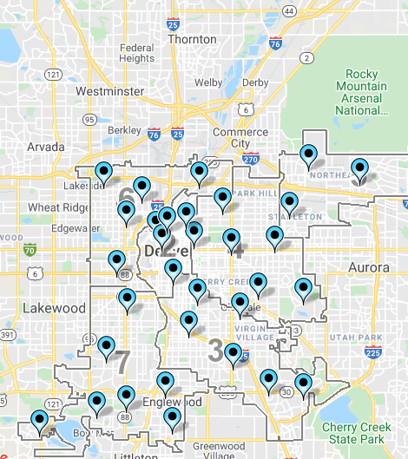

Data
Using Crime data for the County of Denver https://www.denvergov.org/opendata/dataset/city-and-county-of-denver-crime
Over 600 fires in the last 5 years.
Categories of fires: vehicles, residence, business, public building, ‘other’.
There are 40 fire stations in the County of Denver
https://www.denvergov.org/opendata/dataset/city-and-county-of-denver-fire-stations
They’re assigned to “districts” (left)
Image Source: denvergov.org’s Fire Department website

Slide 4
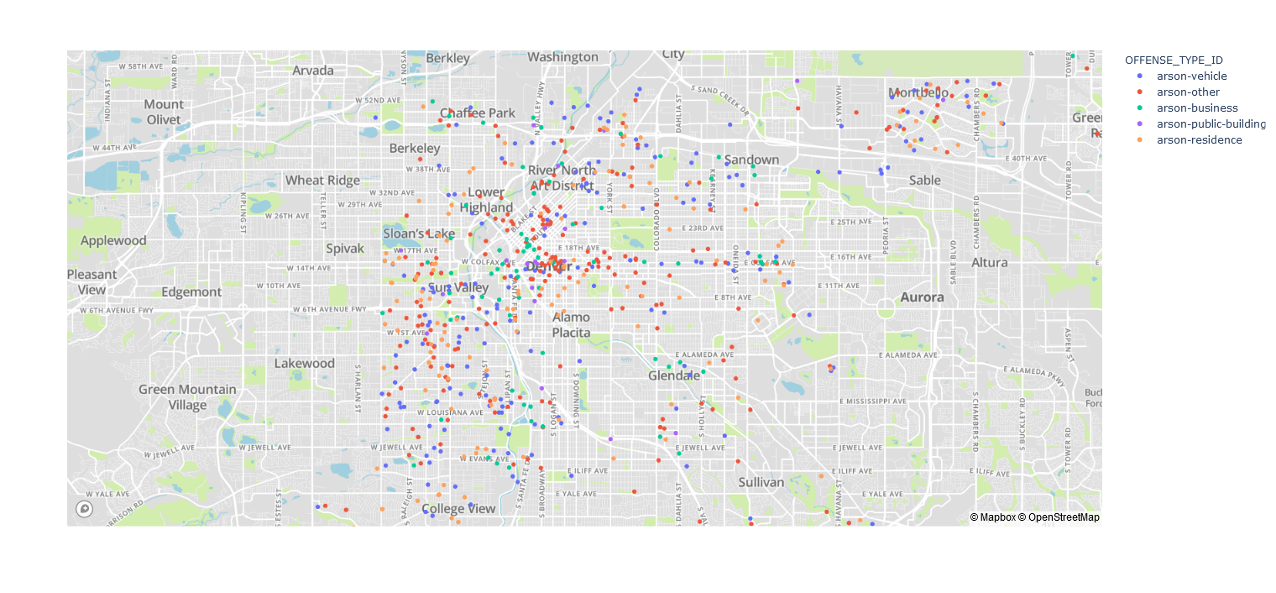
The data, continued

Slide 5
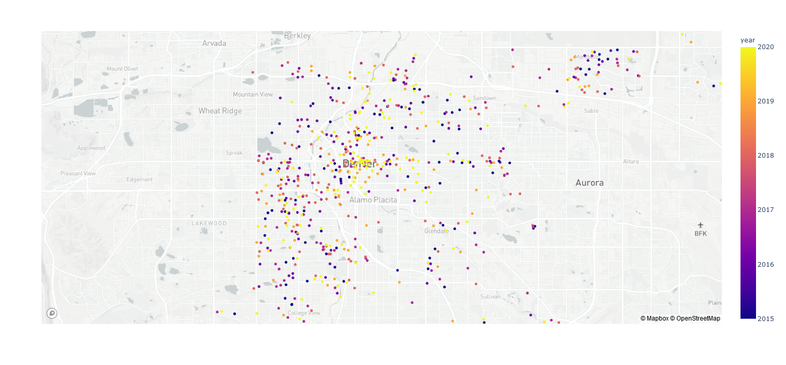
The data, continued

Slide 6
Linear Program
The location of each arson will be derived (previous slide), the distance of each arson to each fire station will be computed.
Using Euclidian distances
We will determine which fire station should respond to each arson fire in such a pattern that minimizes the distances
This would be an assignment problem
The assignment problem is unbalanced with more tasks (arsons) than fire stations
i.e. if a neighborhood has more arson than the others, we could allocate funds to build a fire station within the cluster
Goal: Optimize response to arson calls by the Denver Metro Fire Department

Slide 7
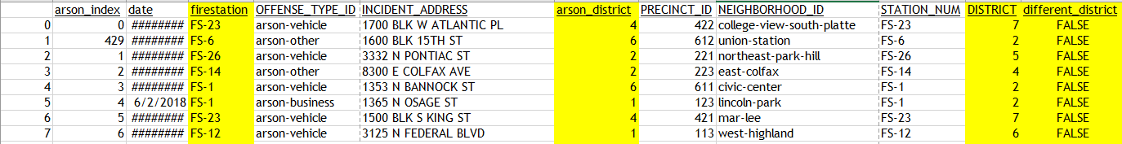
Optimized Output
Each row is a fire reported over the last 5 years
Column ‘arson_district’ is the district in which the fire occurred
Column ‘firestation’ is which station in which the Linear Program recommends to respond to the fire
Column ‘District’ is the district of the fire station that the Linear Program says should respond
Column ‘different_district’ triggers FALSE if the responding fire station is outside of the district in which the fire occurred
Triggers TRUE if the responding fire station is inside the district in which the fire occurred
78% of arsons have a responding fire station outside of its own district

Slide 8
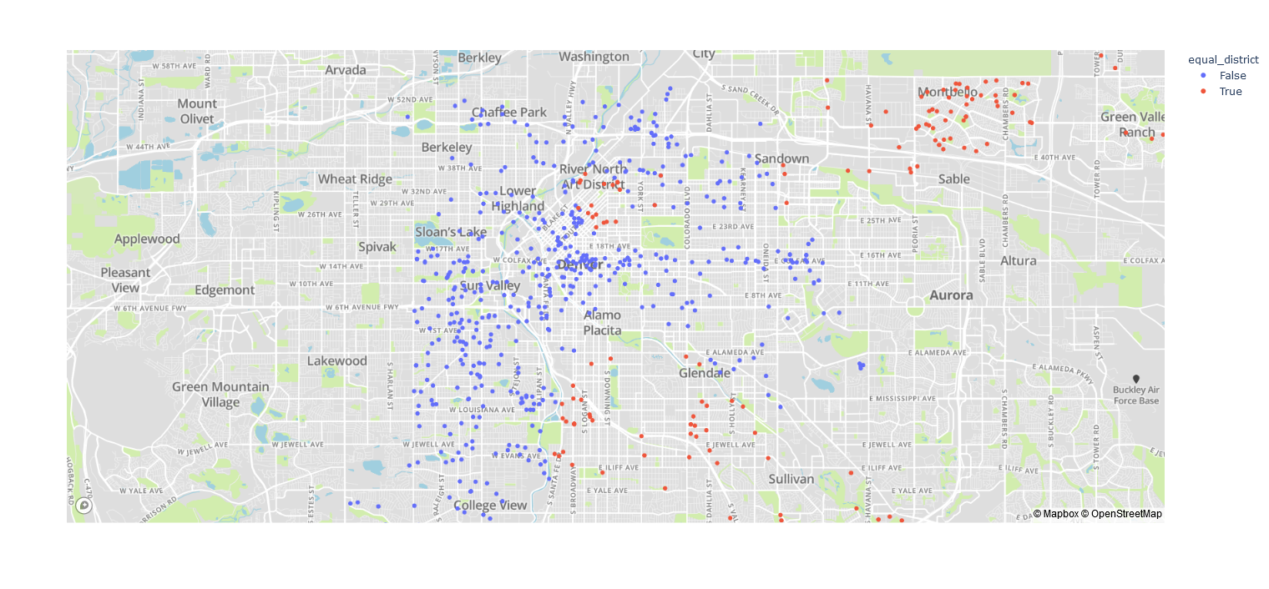
Visualizing the results

Slide 9
Policy Ideas Obtained from Linear Program
We can see that there are an alarming number of fire stations that are responding to fires that are not within their district
We can make the valid argument that there is a need to advocate for funding to build more fire stations within the Denver-Metro Area
For future work we could take a closer look at which district is in the most need of another fire station currently

